Slide 1

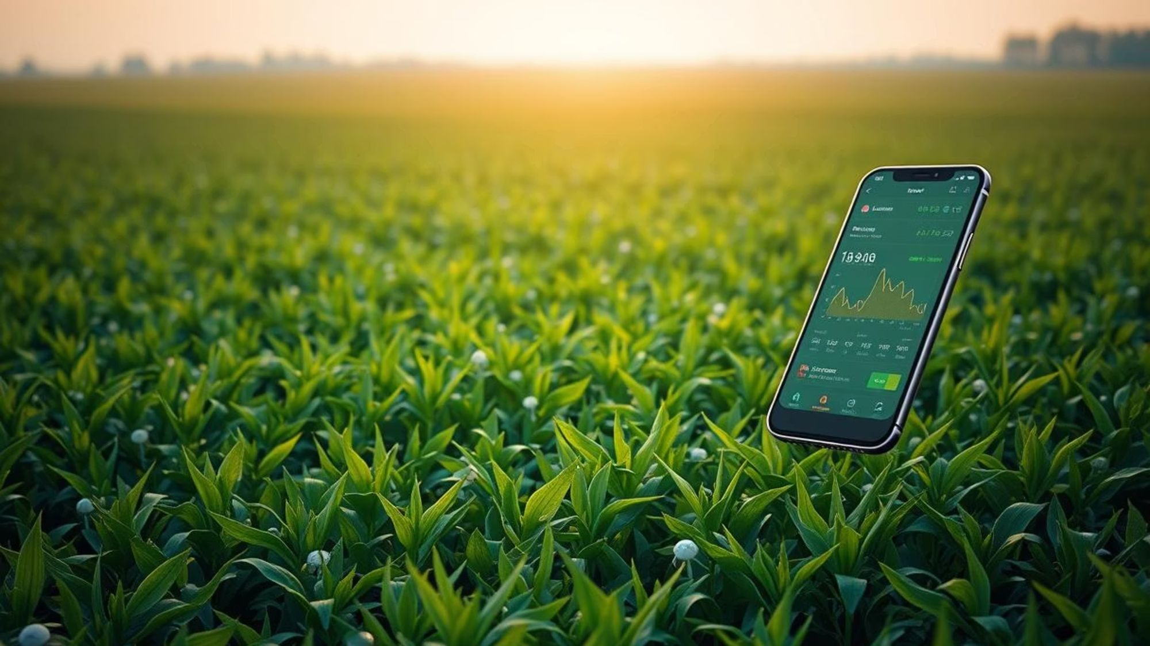
IDEATHON 4.0 IDEA PRESENTATION
KrishiRakshak
Farming Management Assistance and Tracking

Slide 2
Team CyberSquad
From Sanjay Ghodawat University
B.Tech CSE T.Y
Irfan Khudabuddin Mulla
Gomtesh Amol Shetti
Tejas Dharnendra Khot

Slide 3












ABOUT PROBLEM STATEMENT
Clear Description of the Problem
Key Stakeholders Affected
Problem Demands Urgent
Solutions
Lack of Real-time Data
Primary Impact Groups
Economic Imperatives
Poor Resource Management
Small & marginal farmers (85% of India's
Farmers. Subsistence farmers who rely
entirely.
Could significantly reduce farmer distress
and debt cycles.
Post-harvest losses
Secondary Impact Groups
Agricultural & Environmental Benefits
Agricultural cooperatives managing
collective farming operations. Agri-input
Companies. Government agencies.
Reduces 15-20% irrigation-related yield
Losses.Cuts agrochemical overuse. Post
-harvest waste of vital food supplies
Crop health issues
Food processors,retailers,consumers
Social & Technological Transformation
Lack of Personalized Solutions
Dependent on stable crop supply, price
volatility and food safety concerns. Environ-
mental organizations
Democratizes access to AI, IoT and precision
Farming. Bridges the gap between agri-
research and field-level practice.
Limited Technical Knowledge

Slide 4

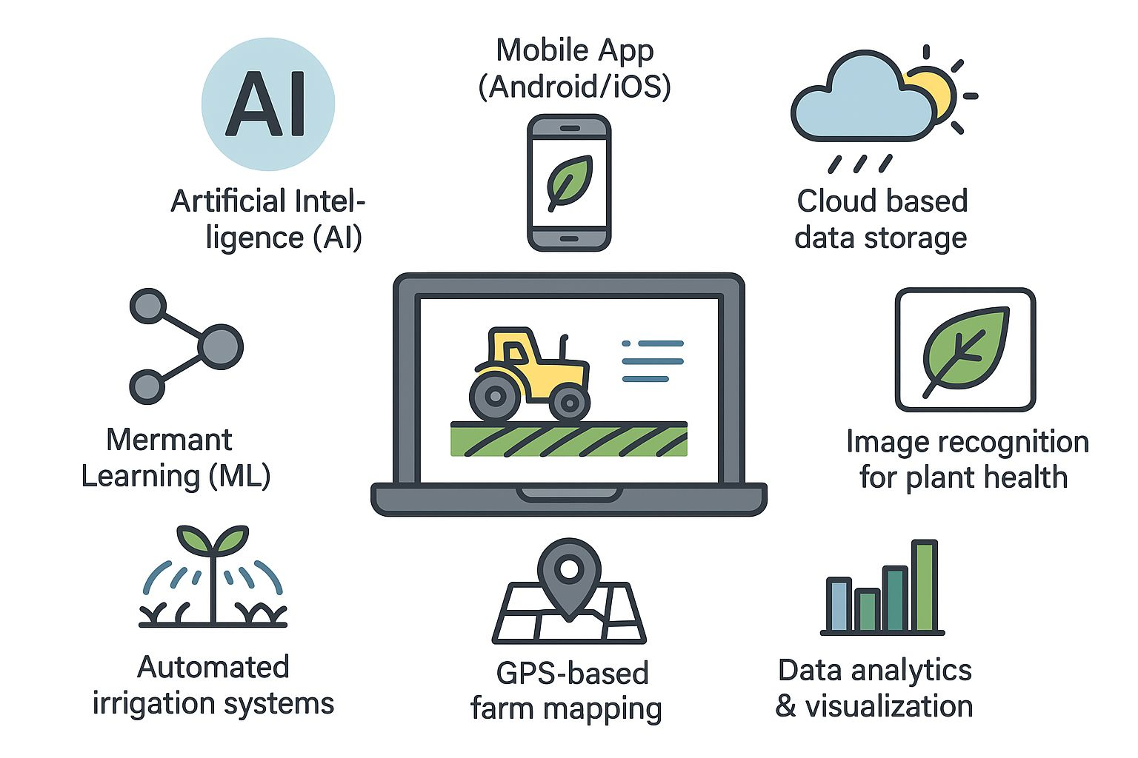




PROPOSED IDEA/INNOVATION
Features
Predicts weather to prevent crop
losses. Automation and forcatation
Market price and demand prediction.
AI-driven pest and disease image
recognition.
Offline mode for remote areas.
AI-based virtual assistant.
Voice interation in local-languages
Description of Innovative Idea Krishi Raksha is a smart agriculture platform powered by IoT, AI, and a personal AI-based virtual assistant bot that acts as a farmer’s personal guide. It monitors crops, predicts weather, detects diseases, automates irrigation, and connects farmers to experts in real time. The assistant communicates in multiple languages, making technology simple, accessible, and personalized for every farmer.
Farm financial management
and tracking.
Community and knowledge-s
haring platform. Expert Suggestions
Personalized crop and financial
planning suggestions.

Slide 5

PROOF OF CONCEPT
Objectives
Methodology
Optimize resource utilization
Soil & weather monitoring
Enable real-time decision-making
AI/IOT Devices prediction models
Boost crop yields
Automated crop calendars
Reduce post-harvest losses
Smart irrigation systems
Support small-scale farmers
Real-time pest alerts
Implement mobile & web dashboard
Integrated financial tools
Real-Time Market Demand Forecasting
Community network for knowledge sharing
Constraints
📶 Limited Internet access in rural areas.
💰 Initial cost of IoT devices.
📚 Need for basic training in using the platform

Slide 6
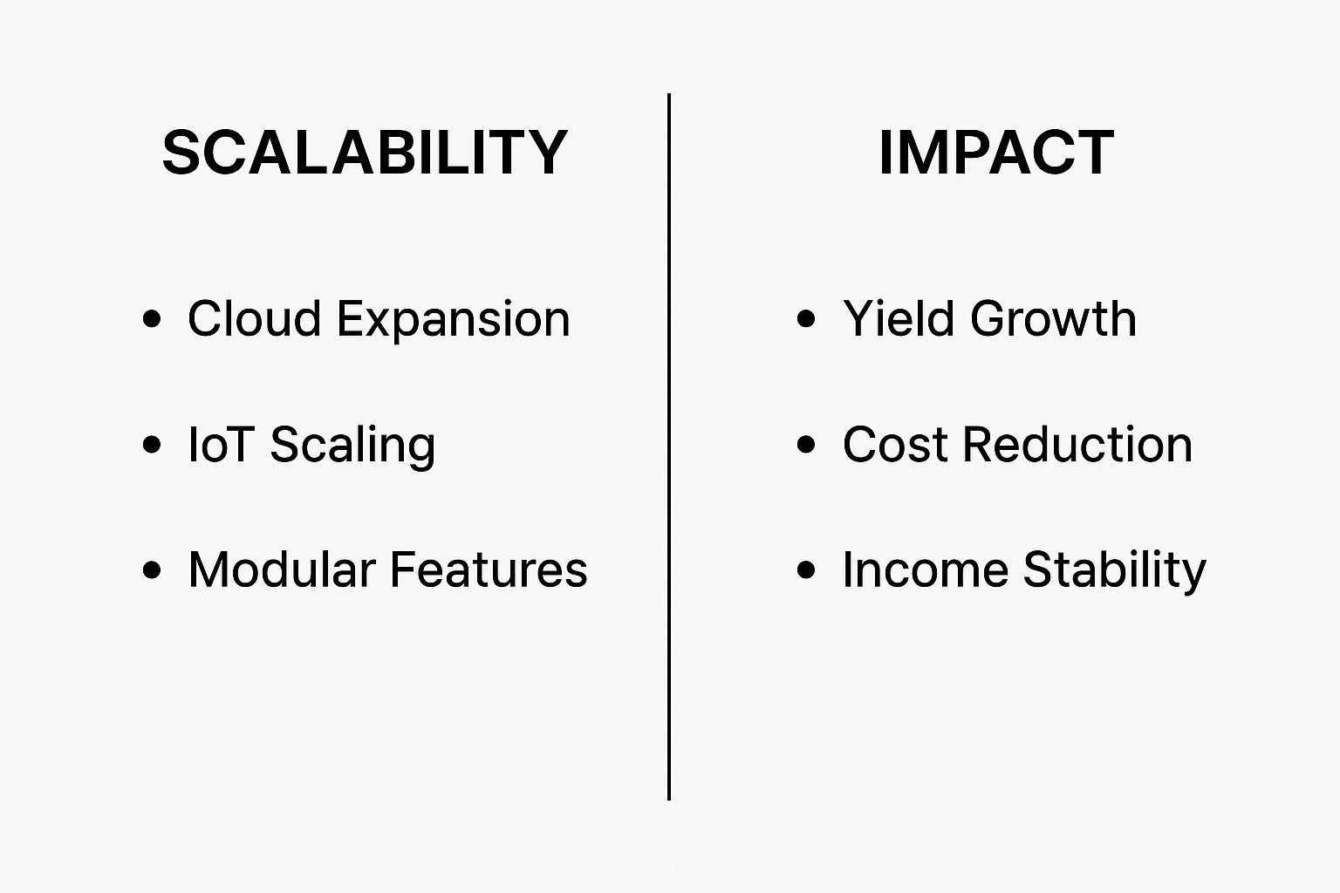
BUSINESS MODEL
BUSINESS MODEL
Target Customers
Monetization
Cost/Revenue
Preemium Model
Subscription Plans
Pay-per-use
B2B Partnerships
Govt. Licensing
Mobile App
Costs:
AI Development
IoT Hardware
Cloud Storage
Customer Support
Marketing Distribution
Revenue:
Subscriptions Fees
Hardware Sales
Data Insights
Brand Partnerships
In-app Ads
Farmers (small, medium, and large-scale)
Agri-businesses & cooperatives
Government agricultural departments
NGOs & rural development organizations
Agricultural equipment and input suppliers

Slide 7
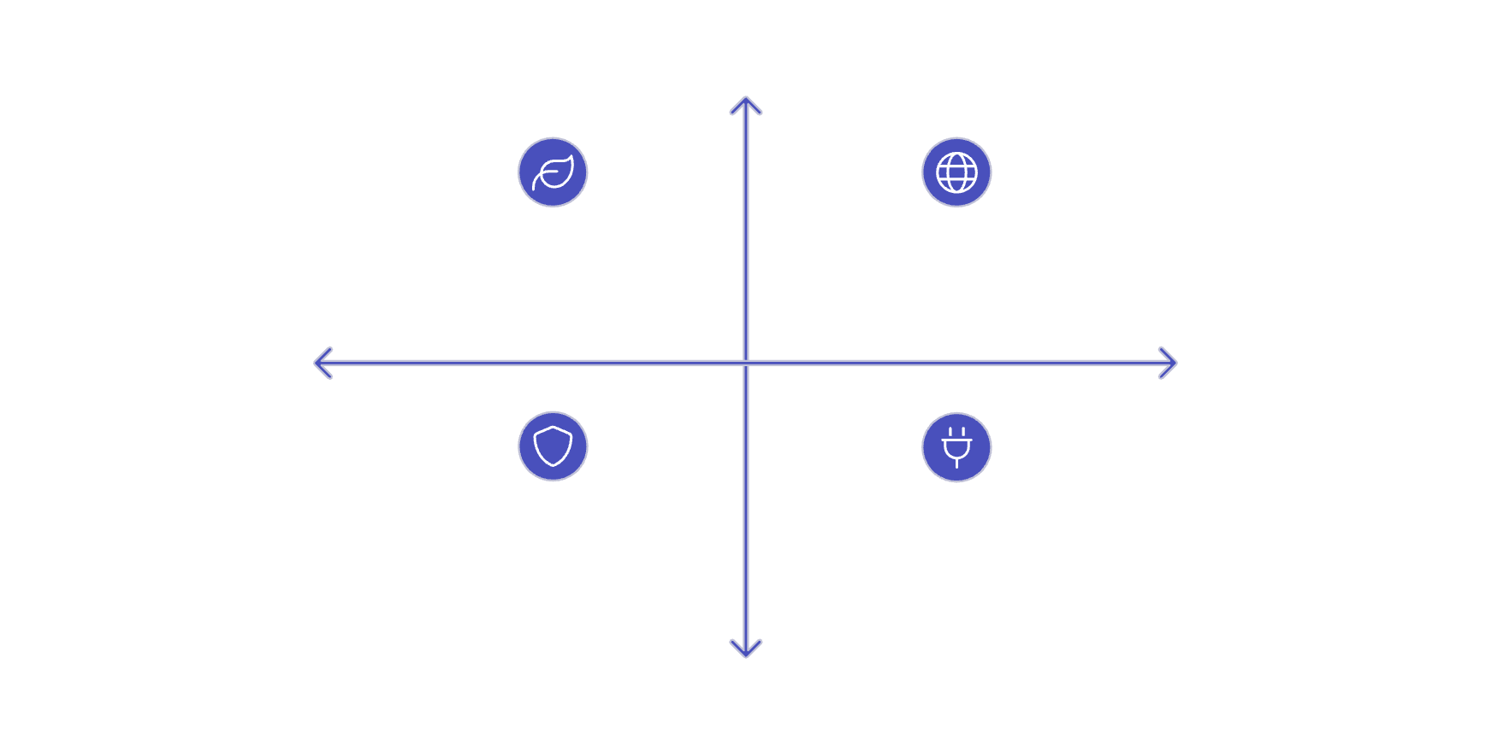
SWOT ANALYSIS OR USP
Unique Selling Proposition
SWOT
Real-time Decision-making
Strengths
Weaknesses
Strengths: Efficiency, Higher Yields, Resource Savings
Weaknesses: IoT Cost, Internet Dependency
All-in-one Platform
Opportunities
Threats
Sustainability Focus
Opportunities: Global Market, Govt Partnerships
Threats: Competition, Weather Risk, Cybersecurity
Offline Mode
Community Support

Slide 8
YOUR CURRENT STATUS AND FUTURE PLANS
Roadmap
Current Status
Short-Term
1
Idea stage completed
Pilot expansion to 500 farms, platform feature enhancements (e.g., multilingual support), strategic partnerships.
Solution concept finalized
Finalized idea & core features of KrishiRakshak
2
Mid-Term
Pan-India rollout, introduction of advanced analytics modules, integration with agri-financing institutions.
Long-Term
3
International expansion, R&D into next-gen agri-tech (e.g., robotics), establishment of a farmer community platform.

Slide 9
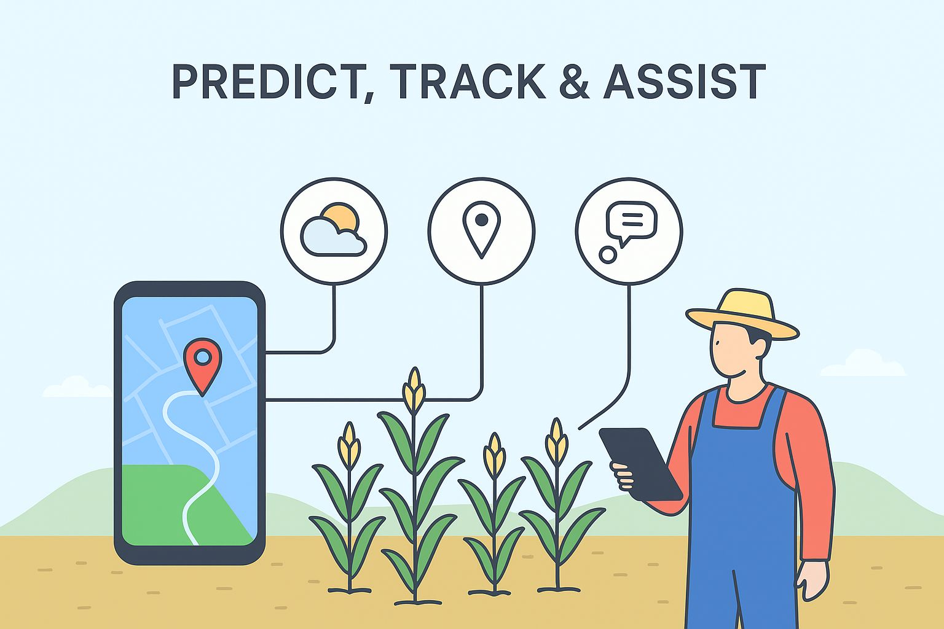
How We Stand Out
📌 Comparison with Existing Solutions
Traditional Farming Apps – Mostly provide weather updates and crop details, but lack AI-driven insights.
Government Portals – Offer subsidies and basic info but limited real-time tracking or IoT integration.
Agri-Market Platforms – Focus on buying/selling produce, not on predictive assistance.
Our Solution – Combines AI, IoT sensors, ML models, and mobile app to predict, track, and assist farmers in real time with personalized insights.
“All-In-One”
“KrishiRakshak”

Slide 10
EXPECTATIONS FROM
NRIT TBI
Mentorship & Guidance
In AI, IoT, and business strategy.
Technical Resources
Access to infrastructure and expertise.
Seed Funding & Grants
Essential for initial development and growth.
Networking Opportunities
Connections with farmers, partners, and investors.
Business Model Refinement
Assistance in scaling and market entry strategies.

Slide 11
YOUR CONTACT DETAILS
Name E-mail Ph.Number
Irfan Khudabuddin Mulla irfankmulla05@gamil.com 8767865949
Gomtesh Amol Shetti gomteshshetti108@gmail.com 6364454108
“Thank you – your insights will help us grow.”

